Slide 1

Class Orchestra and Conducting

Slide 3
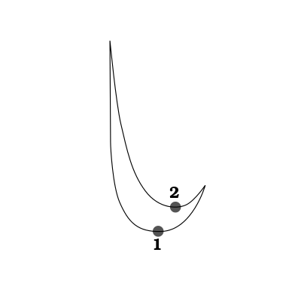

TIP:
As you conduct in 2/4 time think of this action:
Down - Up - Down - Up
2
4

Slide 4
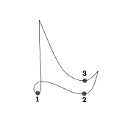
TIP:
As you conduct in 3/4 time think of this action:
Down Right Up Down Right Up
3
4

Slide 5
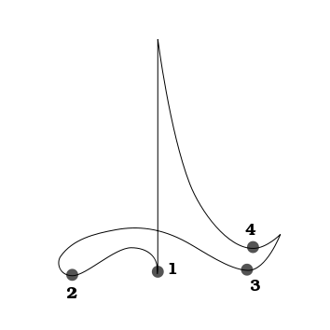
TIP:
As you conduct in 4/4 time think of this action:
Down Left Right Up Down Left Right Up
4
4

