Slide 1
Can You Hear What You See?

Slide 2
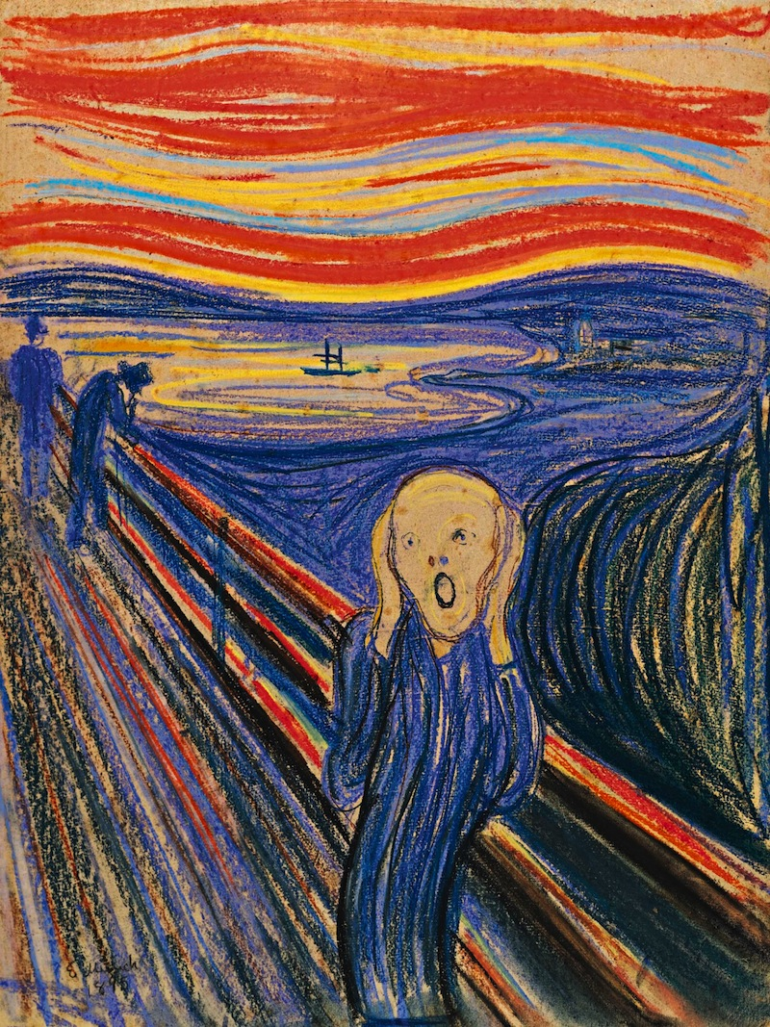
Look at ‘The Scream’ by Munch
What do you see?
Do you just focus on the person in the foreground?
Do you see the gentlemen out for a stroll?
Or the boat anchored in the sunshine?
Discussion Point – What might this painting sound like to you? What instruments and sounds would you use for the sky / the water / the men in top hats / the scream itself?
In the early 20th Century the Expressionist movement in art and music was driven by a desire to represent pure emotion in sight and sound.
Composers such as Schoenberg wrote pieces more to convey emotion and feeling through texture and instrumental colour rather than through conventional melody and harmony. This music is often referred to as ‘atonal’ music.
Listen to ‘Peripetie’ from his ‘Five Orchestral Pieces’ of 1909.
https://www.youtube.com/watch?v=RQ1HFjJxkbY
Discussion Point – how could this music fit this painting’s mood?
(Peripetie can be translated as ‘a sudden change of fortune’)

Slide 3
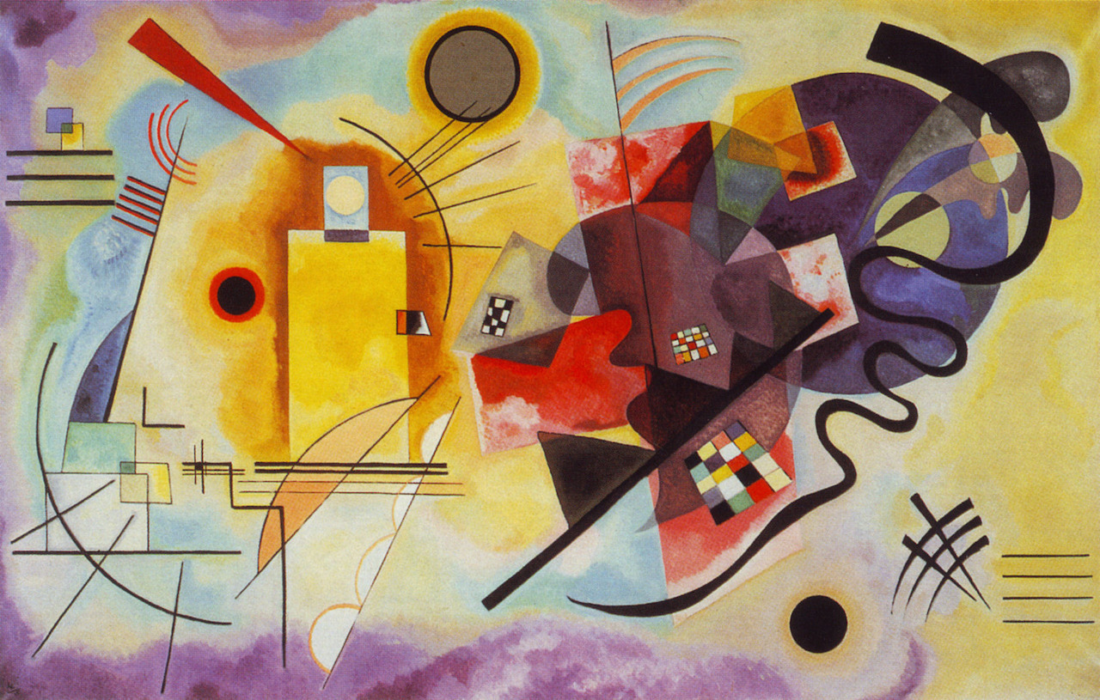
The abstract artist Kandinsky was a friend of Schoenberg and was well-known for associating colours with music and sound.
In his book ‘Concerning the Spiritual in Art’ he considered the sound of his own instrument, the cello, to be ‘the deepest blue’ or green. Yellow sounds could be warm and high-pitched and played by the brass.
White could be silence – quiet and still.
Discussion Point – What do you think of his ideas?
Beethoven referred to B Minor as ‘the black key’ and to D Major as ‘the orange key’ when talking about music.
Look at this painting ‘Red, Yellow, Blue’ by Kandinsky.
What do you see first?
What do you think he started painting first?
Does anything remind you of music?
Composition Task – Choose a section of the painting and using voices, instruments and sounds of your own choosing try to represent your chosen area in sound. Just like Schoenberg consider carefully instrumental colours and combinations, playing techniques and all the elements of Dynamics / Rhythm / Structure / Tempo / Texture

